Slide 1
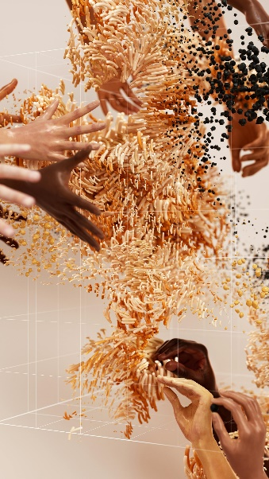




Chemistry Data

Slide 2

Staff for Chemistry

Slide 13
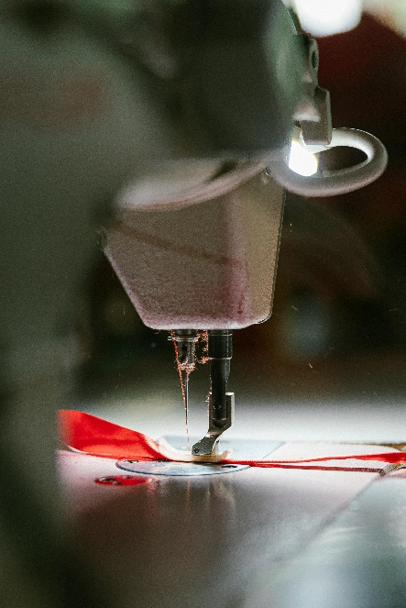


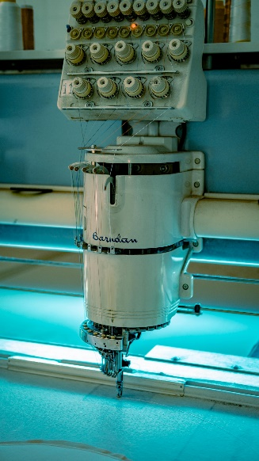
Text Science & App Technology Data

Slide 14

Text Science & App Technology Staff

Slide 22




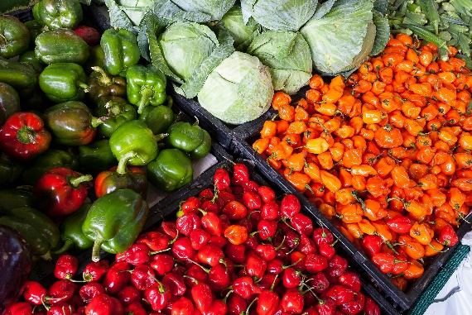
Food and Nutrition Data
Food and Nutrition Data

Slide 23

Food and Nutrition Staff

Slide 29
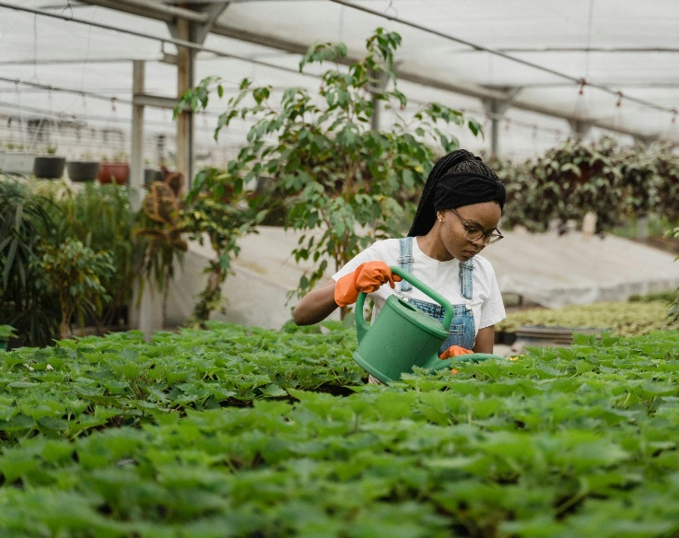


Horticulture Data

Slide 30

Horticulture Staff

Slide 38




Maritime Data

Slide 39

Maritime Studies Staff

Slide 48


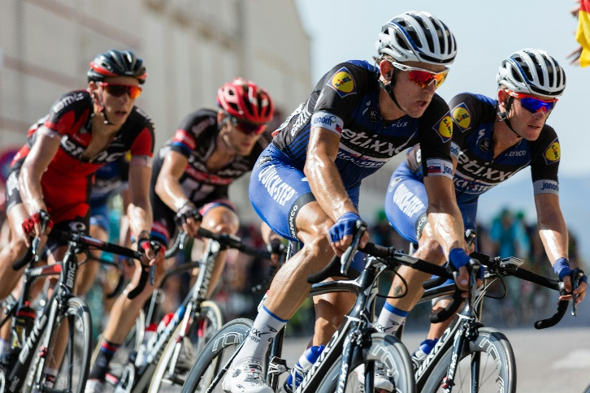

Sport Studies Data
Sport Studies Data

Slide 49

Sport Staff

Slide 55




Statistics Data

Slide 56

Statistics Staff

Slide 61

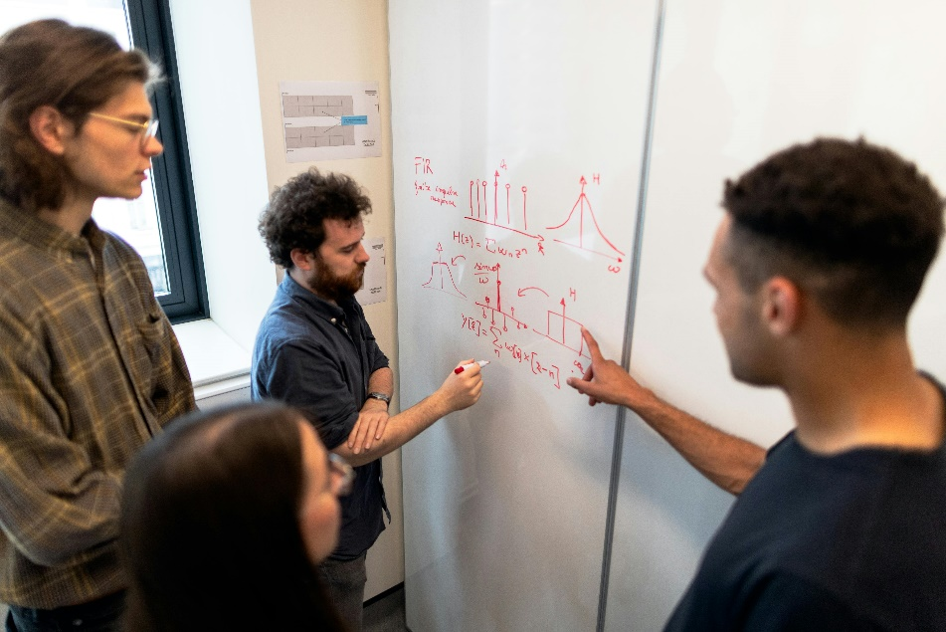


Physics Data

Slide 62

Physics Staff

Slide 67

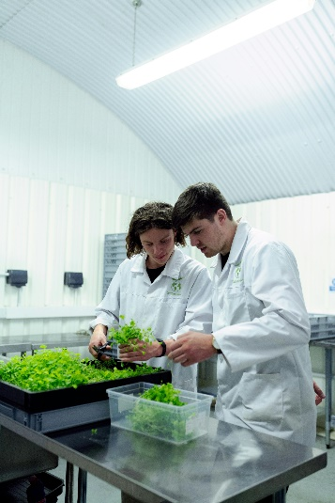

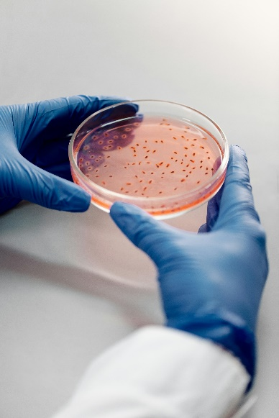
Biotechnology And Food Science Data

Slide 68
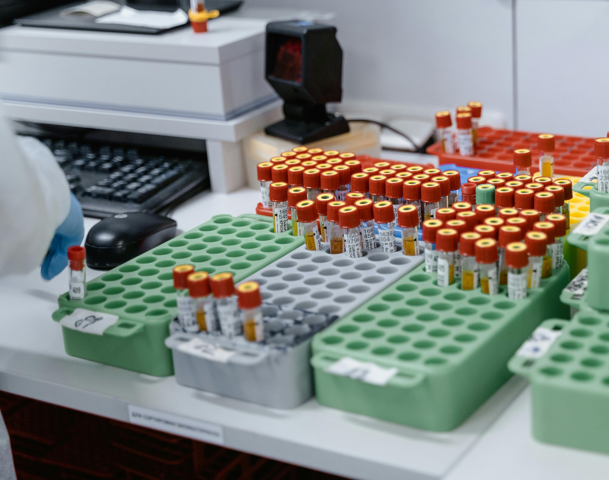
Biotechnology & Food Science Staff

Slide 78

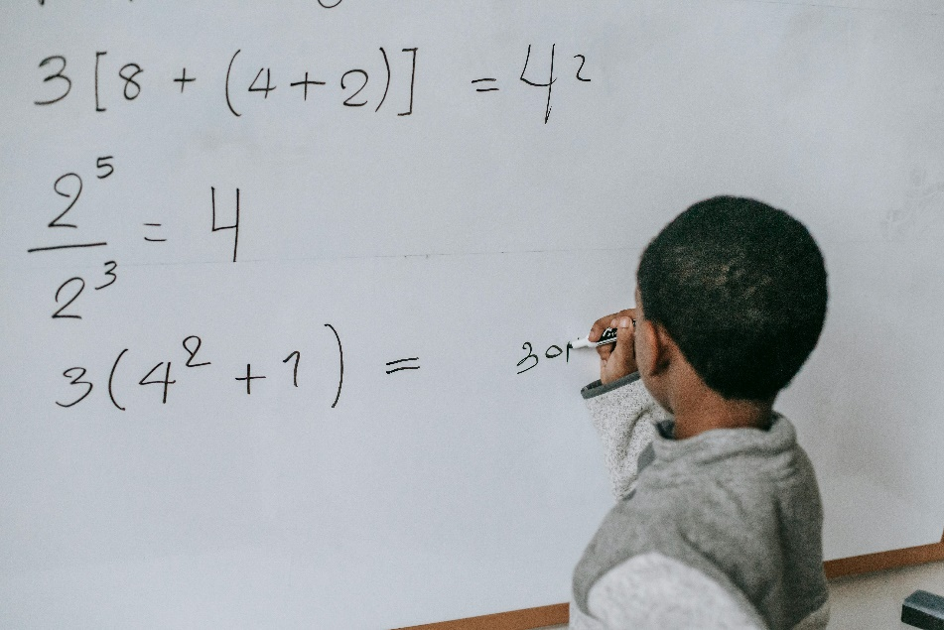
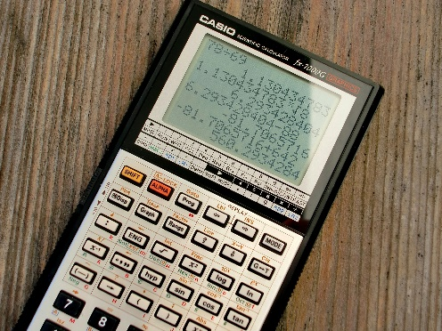

Mathematics Data

Slide 79

Mathematics Staff

Slide 84
Faculty Data

